Slide 1
Western GOA Pcod assessment research
September 2025 Plan Team

Slide 2
Outline
Combined tagging data
Fishery characteristics
Survey index modeling
Brainstorming apportionment options
Future work

Slide 3
Combined tagging data
Collated all available tagging data
Includes both conventional and satellite tags (using only release/pop-off locations)
Starts in 1982, total of 2,930 tags
Filter to:
At least 30 days at liberty
Released and recovered in EBS|NBS, WGOA, and CGOA
 | Release region
 | EBS|NBS | WGOA | CGOA
Pre-2020 | 2,051 | 132 | 453
Post-2020 | 37 | 139 | 67
Total | 2,088 | 271 | 520

Slide 4
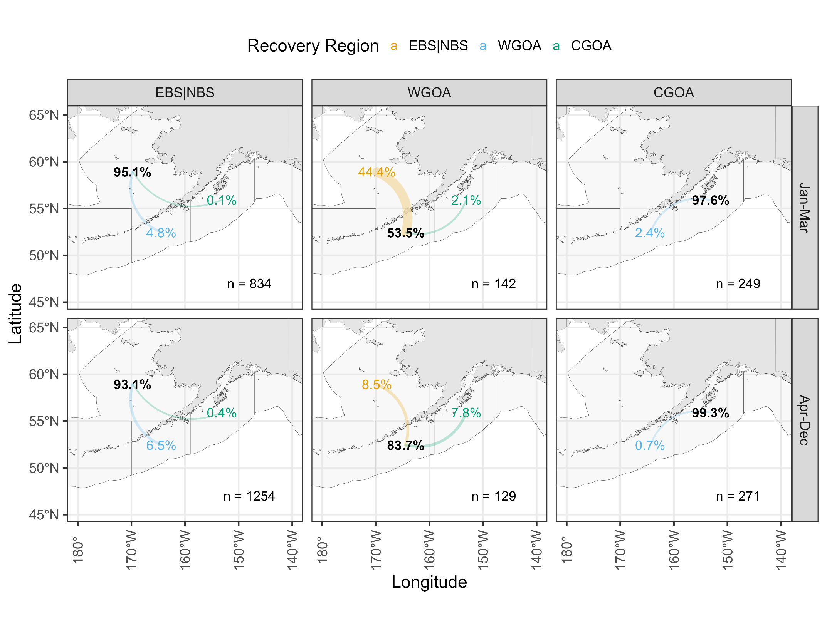

Slide 5
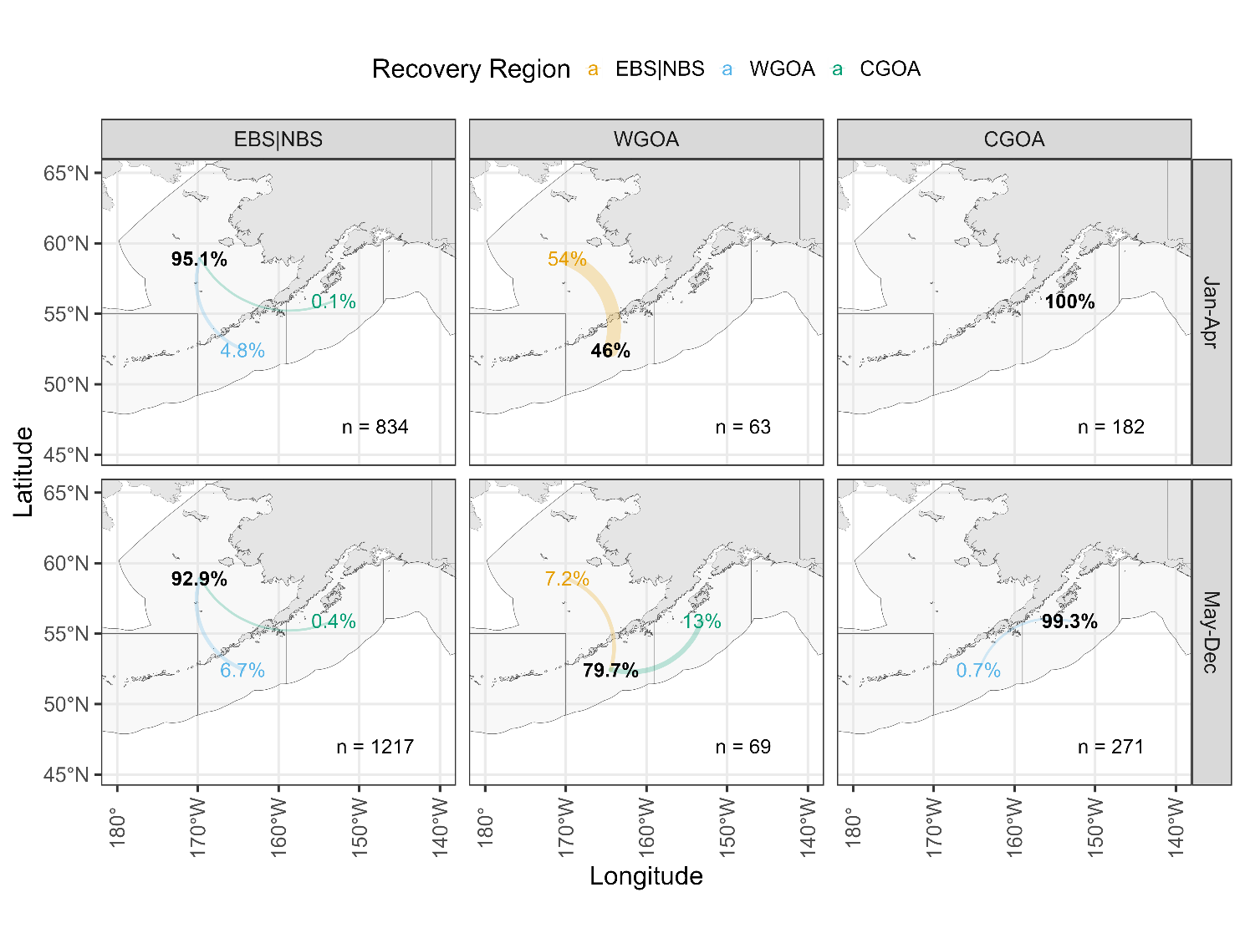
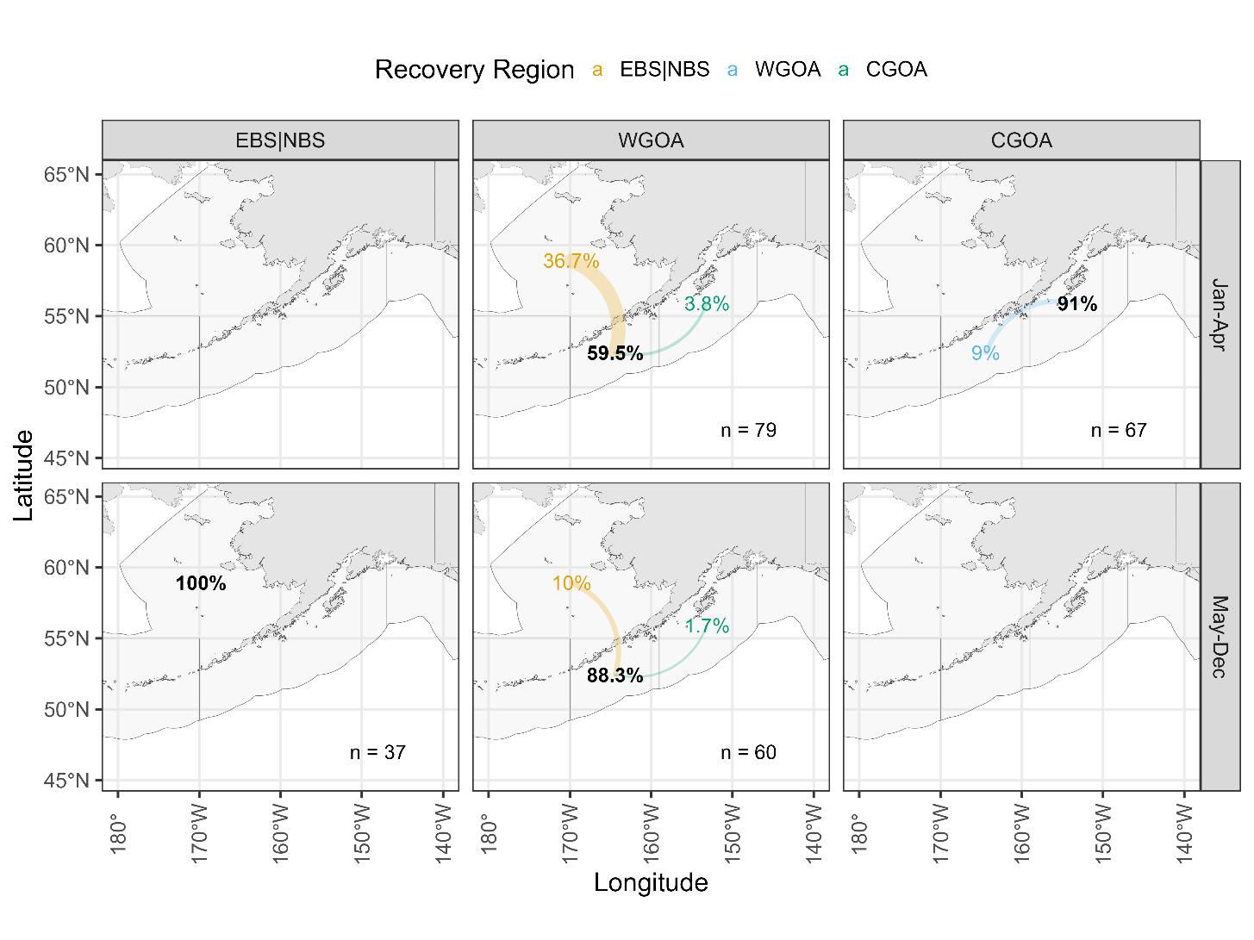
Pre-2020
Post-2020

Slide 6
Combined tagging data
Why Jan-Mar? Seasonality of movement from WGOA:
 | From WGOA, to…
Month | EBS|NBS | WGOA | CGOA | n
1 | 33% | 67% | 0% | 42
3 | 49% | 48% | 3% | 100
4 | 12% | 86% | 2% | 50
5 | 0% | 100% | 0% | 3
6 | 0% | 100% | 0% | 2
7 | 4% | 96% | 0% | 23
8 | 9% | 73% | 18% | 45
9 | 0% | 83% | 17% | 6
All | 27% | 68% | 5% | 271

Slide 7
Combined tagging data
Seasonality of movement from EBS|NBS:
 | From EBS|NBS, to…
Month | EBS|NBS | WGOA | CGOA | n
1 | 84% | 16% | 0.0% | 19
2 | 95% | 5% | 0.1% | 809
3 | 100% | 0% | 0.0% | 6
4 | 94% | 6% | 0.0% | 678
6 | 90% | 7% | 2.8% | 71
7 | 96% | 4% | 0.0% | 82
8 | 94% | 6% | 0.0% | 108
9 | 94% | 6% | 0.7% | 141
10 | 84% | 12% | 4.0% | 25
11 | 90% | 9% | 0.7% | 149
All | 94% | 6% | 0.3% | 2088

Slide 8
Combined tagging data
Take homes:
WGOA has largest amount of movement out of the region as compared to EBS|NBS and CGOA
Strong seasonal component, bulk of movement from WGOA to EBS|NBS occurs prior to April
Recent tagging has less movement to EBS|NBS (~37%) as compared to historical tagging data (~54%) prior to April
EBS|NBS movement to WGOA consistent across month/season, and hovers ~6%
CGOA has limited movement to WGOA, none to EBS|BS

Slide 9
Fishery characteristics
Catch from Cod-targeted trips by season:
 |  | Jan-Mar | Apr-Dec
610 | Pre-closure | 83% | 17%
 | Post-closure | 82% | 18%
620 | Pre-closure | 76% | 24%
 | Post-closure | 65% | 35%
630 | Pre-closure | 77% | 23%
 | Post-closure | 72% | 28%

Slide 10
Fishery characteristics
WGOA catch from Cod-targeted trips by gear and season since 2020:
 | Jan-Mar | Apr-Dec | % of total catch
Pot | 95% | 5% | 52%
Trawl | 97% | 3% | 24%
Longline | 45% | 55% | 19%
Jig | 19% | 81% | 5%

Slide 11
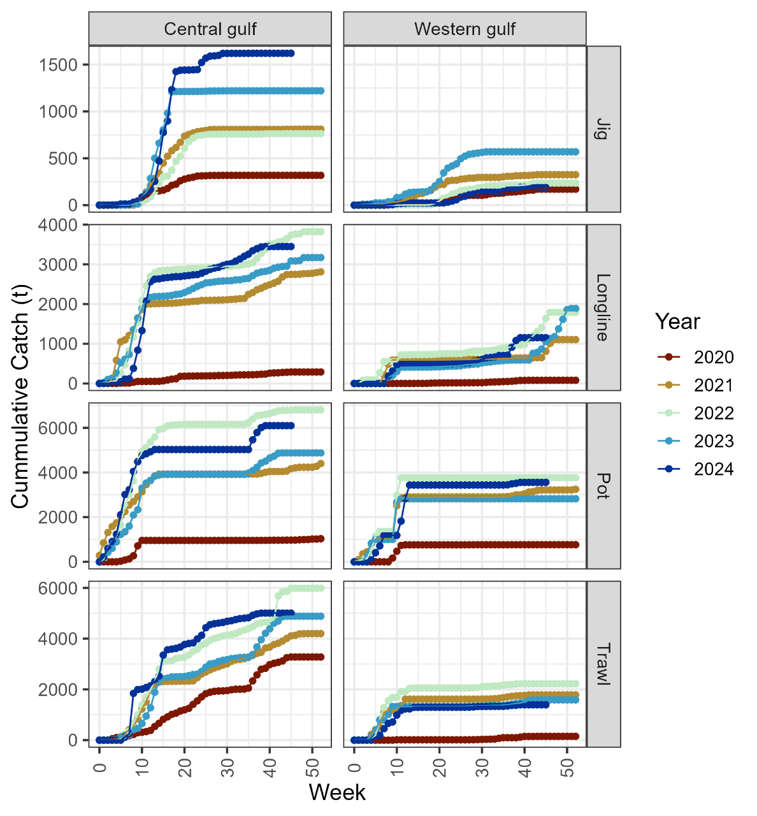
Fishery characteristics
Take home:
Majority of cod-targeted catch in the WGOA and CGOA is landed prior to April, with larger proportion in the WGOA
Within WGOA, this holds particularly for Pot and Trawl
This coincides within the time period when EBS|NBS fish are in the WGOA
Likely that presence of cod in Jan-Mar not the limiting factor for catch in the WGOA

Slide 12
Survey index modeling
sdmTMB used to estimate model-based indices for EBS|NBS, WGOA, and combined EBS|NBS – WGOA
Provides annual estimates of survey (summer) biomass in order to compare between regions, and combination of regions

